Slide 1
Data Analysis for Vehicle Claims
Team members:
1.Reena.D [711715104048]
2.Sathyan.S [711715104052]
3.Vinayagamoorthy.G [711715104072]
Industry Mentor
Ms.Yuthika.V
Faculty Guide:
Ms.Sreeja.G.G
Department of CSE, KGiSL Institute of Technology, Coimbatore

Slide 2
Abstract
A system that helps in visualizing and analysing the motor insurance vehicle claims. It distributes interactive and sharable dashboards which depict the trends variations and density of the data in form of graphs and charts. It will be useful for future prediction and comparison of data.Claims analysis is a technique for examining the positive and negative consequences of design features that are described in current or future scenarios of use. A "claim" is a statement of the consequences of a specific design feature or artifact on users and other stakeholders. This system is planned to build using the TABLEAU software to visualise the data.
Department of CSE, KGiSL Institute of Technology, Coimbatore

Slide 3
Area Introduction-Existing system
In existing System, that will collect the information and perform the analysing operation manually.
The existing system contains modules like cover note & quotation insurance, underwriting, renewal & endorsement.
Disadvantages of existing system:
It will only work on small size of data
Manually processed
Non predictive
Maintenance is difficult
Department of CSE, KGiSL Institute of Technology, Coimbatore

Slide 4
Proposed System
Proposed System is to implement latest technology for making the system still more beneficial to cover the core areas.
Advantages over existing methods
This system is planned to build using the TABLEAU software to visualise the data.
Prediction
Working on large number of data
Classify the insurance claim details
Visualizing the data in the form of charts and graphs.
Predict the types of claims.
Department of CSE, KGiSL Institute of Technology, Coimbatore

Slide 5
Literature Review
Existing projects:
1.NSURE motor policy insurance system
Drawbacks of existing methods
There is no options for visualising the data
There is no prediction system
Department of CSE, KGiSL Institute of Technology, Coimbatore

Slide 6
Architectural Design
Collect the data
Data base
customer
Data collection
store
Data cleaning
retrieval
Analyzing the data
Analyzing and visualizing data
Compare with all constraints
Comparison of data
Prediction of future claims
prediction
Interpret the result
Deliver to customer

Slide 7
Data Flow Diagram-Level 0
Claim
analyse
System
0.0
Customer
get claim detail
analyzing process
data
claim report

Slide 8
Data Flow Diagram-Level 1
policy number
Claim
details
1.0
Customer
Date
get claim detail
data
Type of claim
Location
Personal info
Analyse claim
2.0
claim report

Slide 9
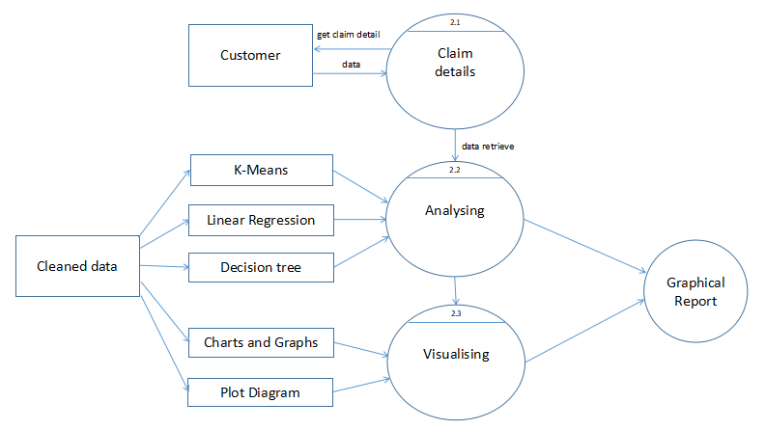
Data Flow Diagram-Level 2

Slide 10
Module Split-up
Data collection
Analysing and Visualizing the data
Comparison of data
Prediction and Report
Department of CSE, KGiSL Institute of Technology, Coimbatore

Slide 11
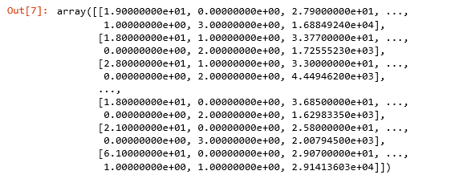
Screen shots of modules under progress Cleaned data:
Eg :

Slide 12
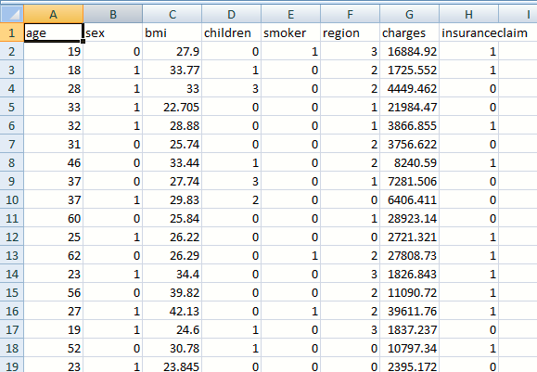

Slide 13
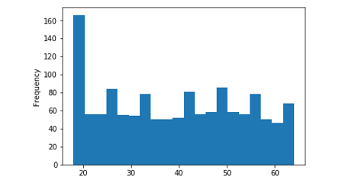

Slide 14
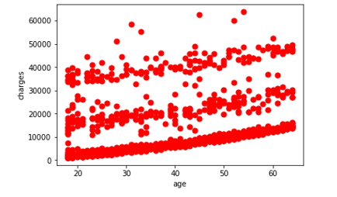
Scatter Plot

Slide 15
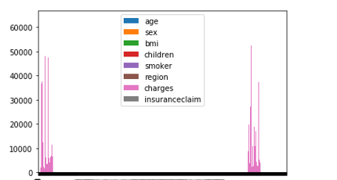

Slide 16
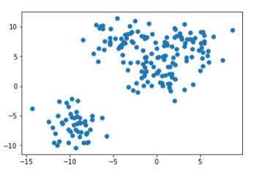
K-Means

Slide 17
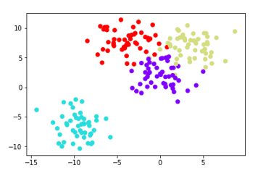

Slide 18
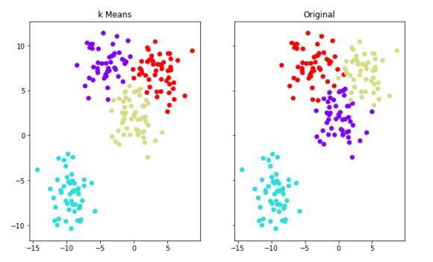

Slide 19
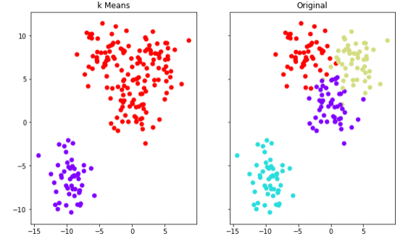

Slide 20
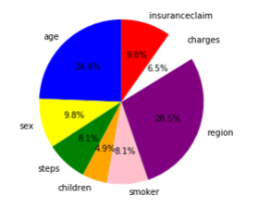
Pie Chart

Slide 21
THANK YOU

